Slide 1


IOYou
DBMS Project
Prasanna Natarajan
1410110298
Vedant Chakravarthy
1410110489

Slide 2
Project Statement
Create an application that works as a debt manager or an I-Owe-You.
The target devices for this application are those with the Android 5.0+ operating systems.
The database management software it uses is SQLite and MySQL.

Slide 3
Platforms and Technologies used
SQLite
Android
XML
PHP
Java
MySQL

Slide 4
Application Features
Sign up
Login
Transact with contacts and up-synchronize with the cloud
Down-synchronize transactions that involve appropriate user
Maintain login, debt and transaction information across multiple devices

Slide 5
Tables
Debt(Locally stored on device)
Email_id (VARCHAR(50)) | Amount (int(6)) | Sync int(1)
Transaction(Local)
From_ID (VARCHAR(50)) | To_ID (VARCHAR(50)) | Amount (int(6)) | Sync int(1) | Timestamp DATETIME

Slide 6
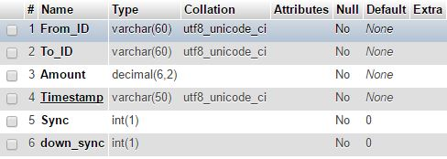
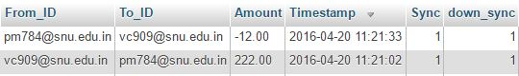
Tables
Transaction(Online)

Slide 7
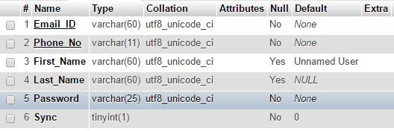
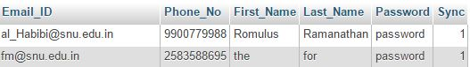
Tables
User(online)

Slide 8
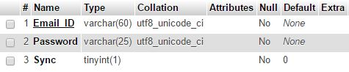
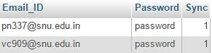
Tables
Login(online)

Slide 9
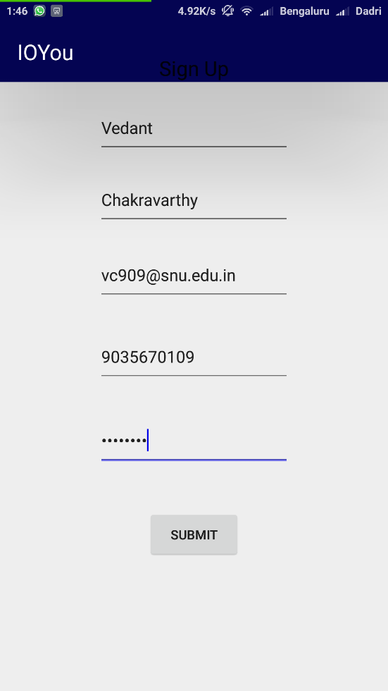
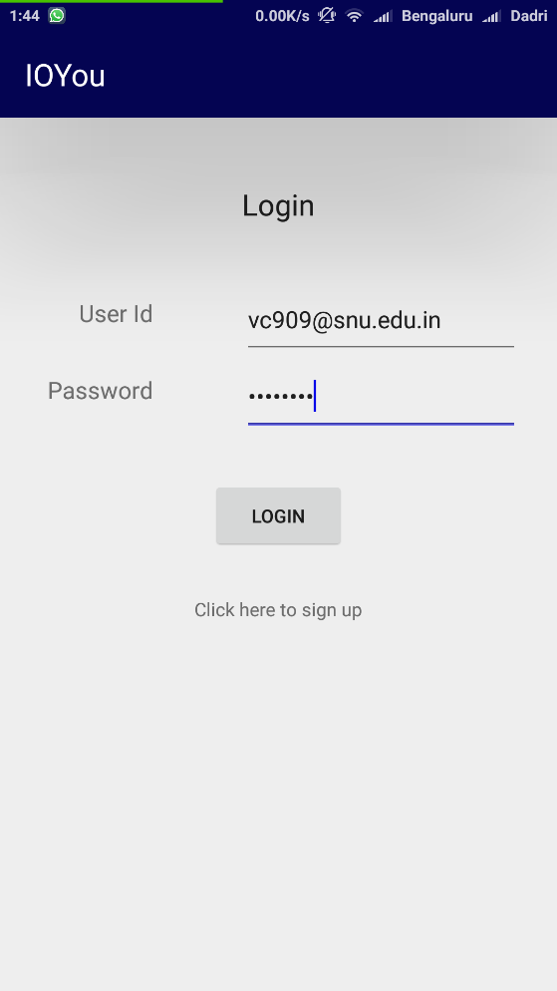
Deployment
Signup
If no other user with same name exists, creates a user when connected to the internet, updates user in online table
Redirects to login page

Slide 10

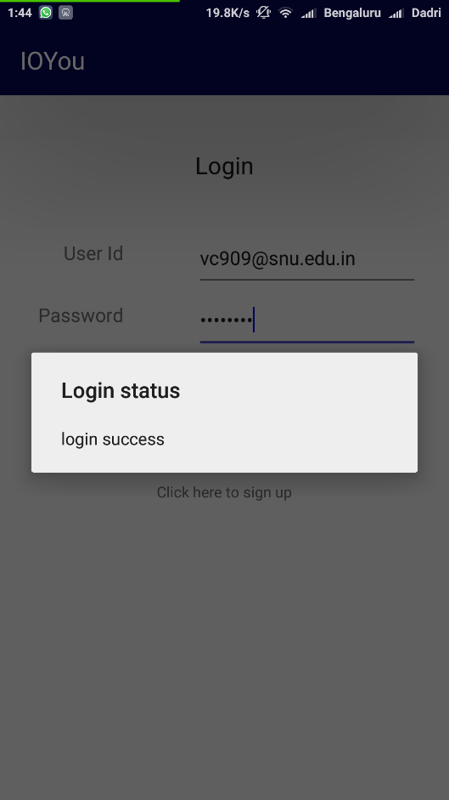
Deployment
Login
Logs user in and keeps user logged in, one login per device
Adds user details to online login table

Slide 11
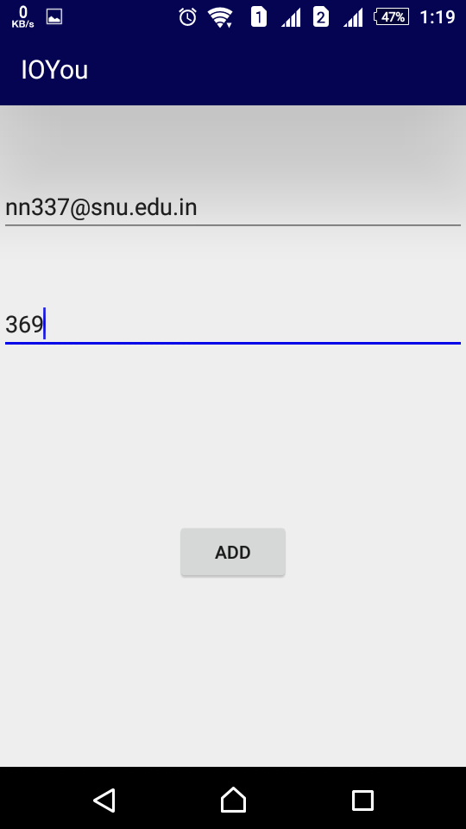
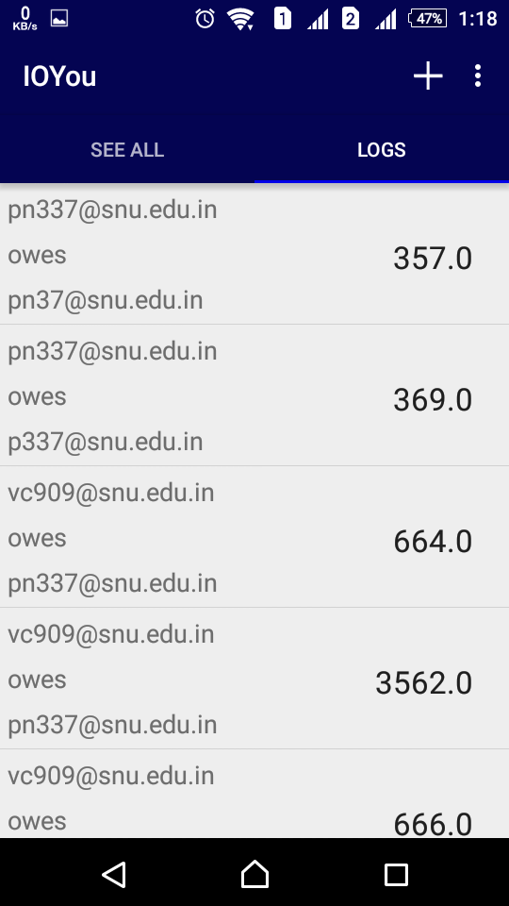
Deployment
Add an IOYou transaction
Transaction completed offline and data added to offline table
Data also uploaded to local Debt table

Slide 12
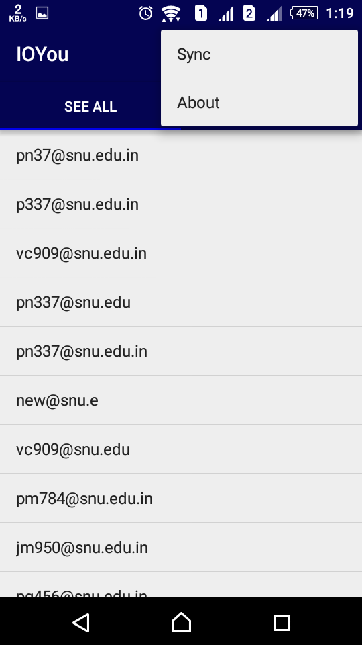
Deployment
Synchronize
Two operations occur here
Up synchronize synchronizes all transactions in the local table that have not yet synchronized into the online table
Down synchronize synchronizes all transactions that exist in the online table related to this particular user that do not exist in the local table

Slide 13
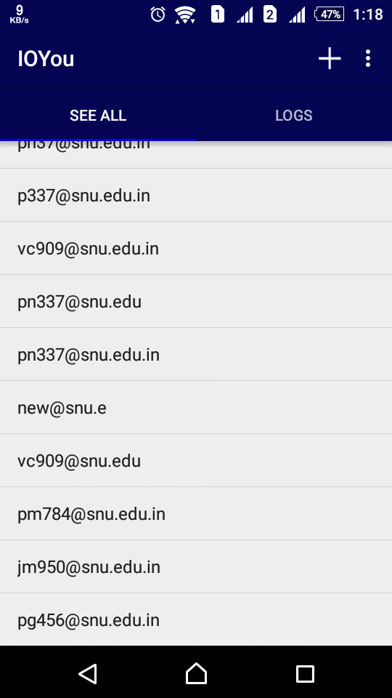
Deployment
Debt
Locally, a Debt table records the net amounts due between two parties involving the user and keeps the net debt in a table

Slide 14
End

